Slide 1
Touch 22
Multi-touch Screen
And Painting Canvas
Logan Moseley, Dan Moseley, Danielle Geffert, Jon Wu

Slide 2
The Touch Screen
Made with easily obtainable materials: plexiglass, LEDs, electrical wire, transistors, aluminum, and a webcam.
How it works:
Infrared LEDs’ light bounces through the glass.
When the surface is touched, some of the IR light is redirected to the webcam.
The computer interprets the webcam vision into touches. Very sophisticated and very cool.
Notes:
Logan

Slide 3
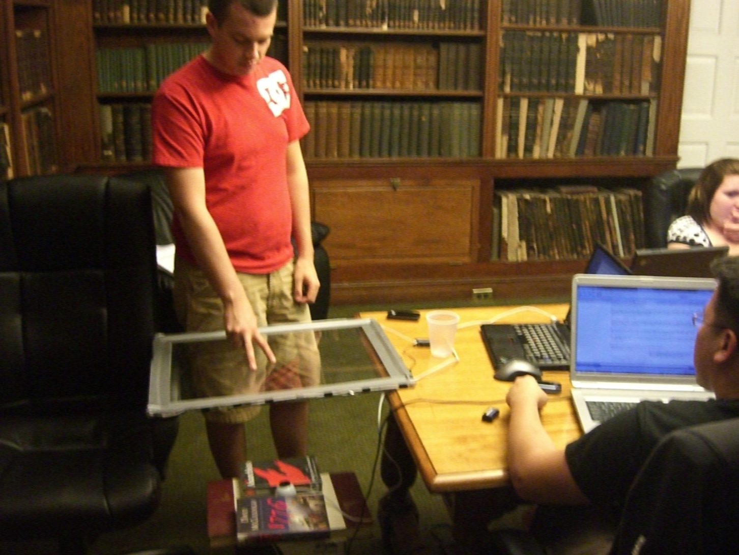
Dan is testing out the screen. The camera is just two feet away, watching, waiting.³

Slide 4
“uTouch” Painting Program
Very simple painting program.
Features are activated and deactivated by touching the button on the screen.
These features include color select, brush size select, lines, color fill, color sampling, clear\erase\undo, save\load, and shape stamps, as well as basic painting.
Like finger painting!
Download uTouch.²
Notes:
Danielle

Slide 5
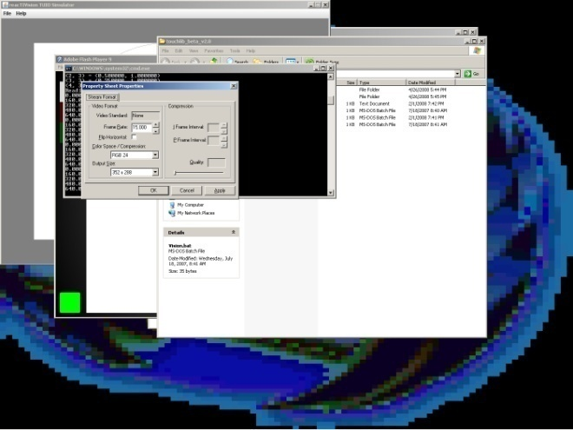
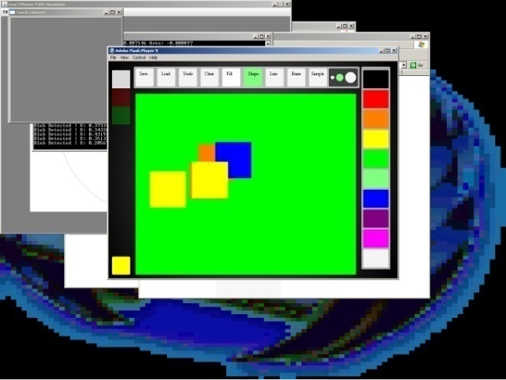
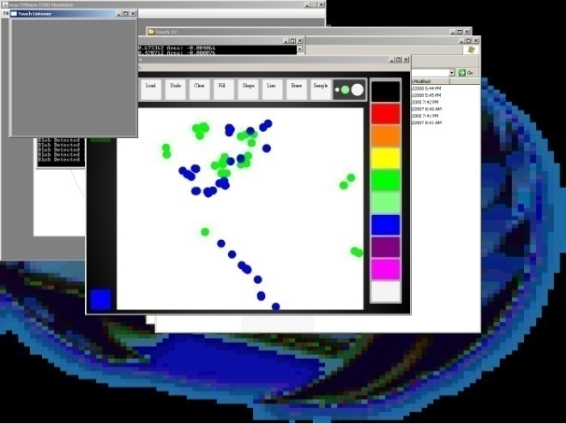
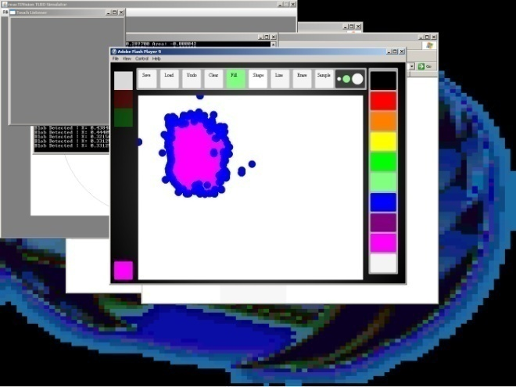
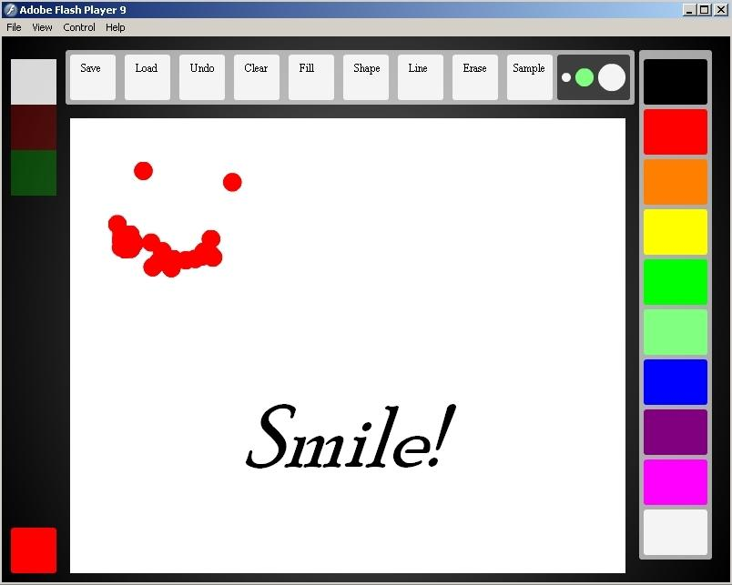
Touch 22’s uTouch
painting program in action.

Slide 6
Why Multi-Touch?
Multi touch allows for multiple points of interaction with the screen.
It provides the ability to support multiple users simultaneously.
Touch-based computer interfaces are more intuitive, flexible, and fun than standard keyboard and mouse.
Notes:
Jon

Slide 7
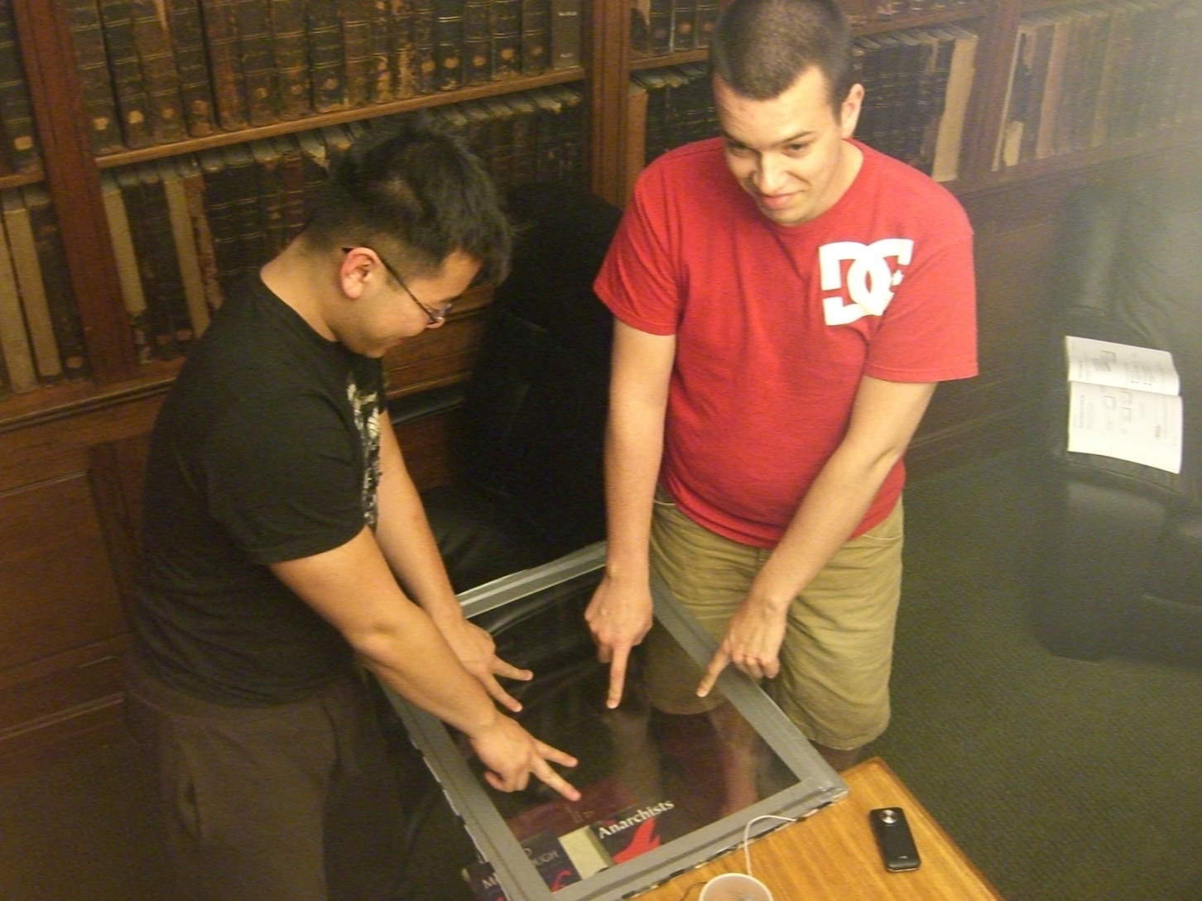
Jon and Dan try to draw a stick figure. It’s not working out so well.³

Slide 8
Construction
Cut aluminum to a frame for the glass.
Attach IR LEDs to the frame, connect LEDs to a battery via electric wiring.
Point visible light-filtered webcam at the glass.
TouchLib vision and calibration tools allow uTouch to “see” touches to the screen.
See NUI Group for more details.¹
Notes:
Dan

Slide 9
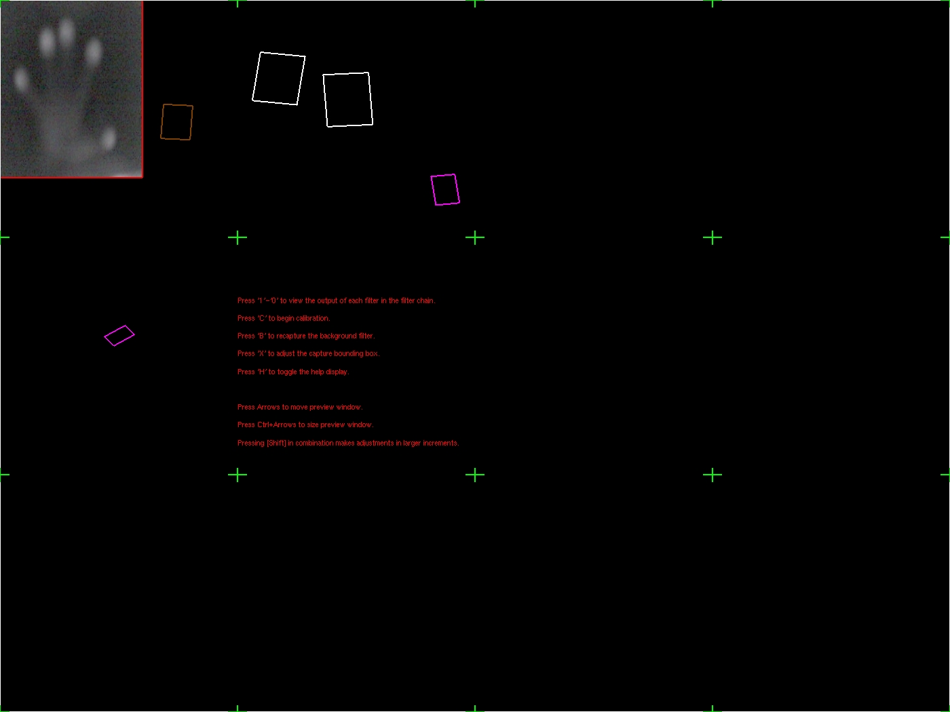

Slide 10
Development Software
TouchLib
www.touchlib.com
TuioSimulator
http://reactable.iua.upf.edu/?software
Adobe Flash Creative Suite 3
http://www.adobe.com/products/flash/
Notes:
Dan

Slide 11
References
NUI Group TouchLib Forums
http://nuigroup.com/forums/viewforum/27/
Google Code
http://code.google.com/p/touch-22/
Touch 22 WikiDot
http://touch22.wikidot.com/
Log Moseley, Dano Moseley, Ganielle Deffert, Jonny Wu
Notes:
Logan

